Slide 1
The Salty Sun
Stellar Sodium Abundance
Sydney Petz, Aiden Zelakiewicz, Justin Anderson

Slide 2


Why Use Stellar Spectra
Search for life and habitable worlds
Need to understand planetary atmosphere to constrain habitability
Can approximate certain chemical species in planet from their host star

Slide 3
TABLE OF CONTENTS
01
02
03
04
Ground State Na
Boltzmann Equation
Finding the number of sodium atoms in the ground state
Ratio of sodium atoms in excited versus ground state
Saha Equation
Na Abundance
Ratio of neutral to ionized sodium atoms
Calculating the sodium abundance

Slide 4
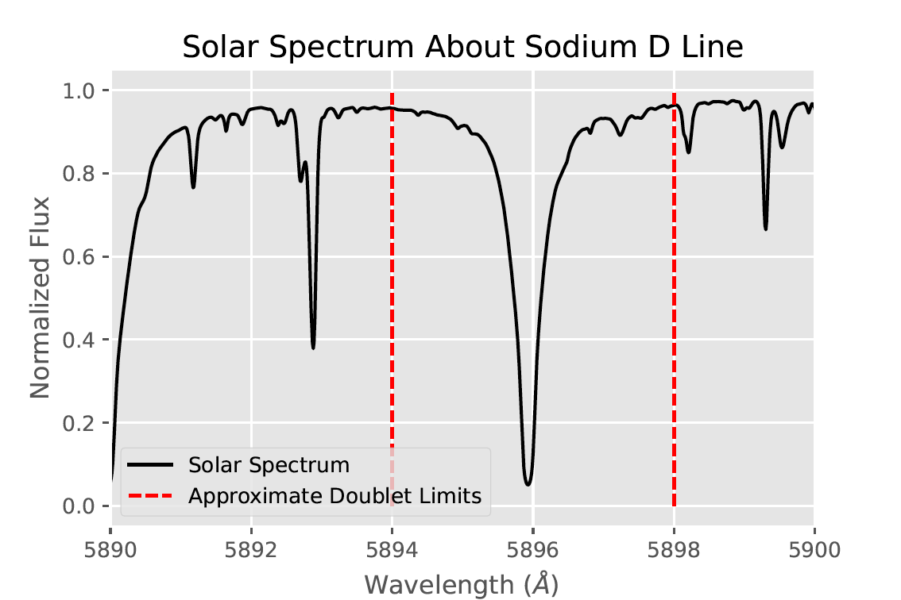
01 - Ground State Na
Use 5896Å sodium line
Evaluate equivalent width
Solve for log(EW/𝛌)
log(EW/𝞴) = -3.96
Notes:
Using data from the Solar Spectrum Archive, we focus around the 5896 Angstrom sodium doublet absorption feature.
We derive the equivalent width and use it to calculate the log of EW over lambda, where lambda is our 5896 line.

Slide 5
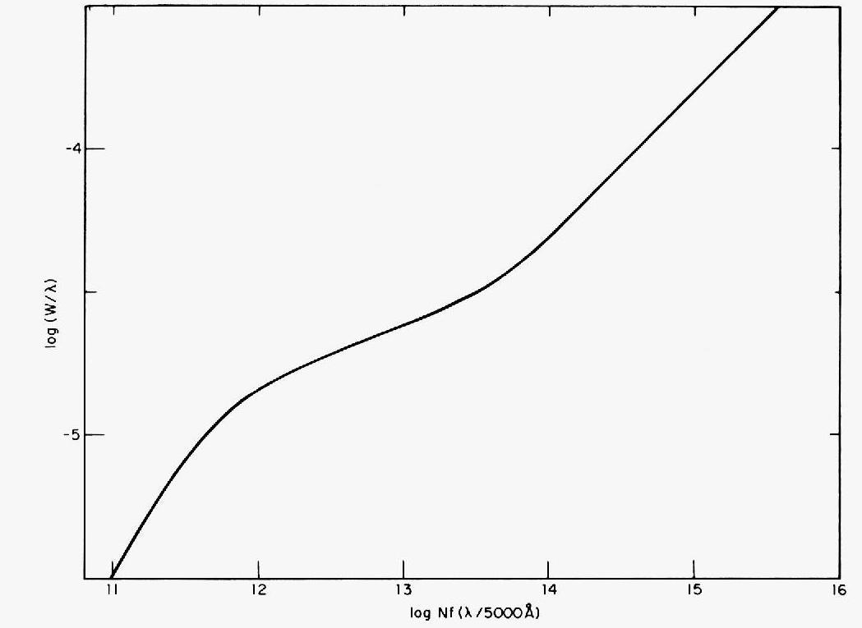
Match log(EW/𝛌) value to logNf(𝛌/5000Å) value
Solve for the number of sodium atoms in the ground state
N = 5.19x10¹⁴ atoms
Aller & Goldberg 1971
Notes:
Using this general growth curve from Aller 1971, we match ~-4 value to the x axis, through which we can solve for the number of ground state sodium atoms, N.
This yields a total of approximately 5.19 times 10^14 atoms.

Slide 6

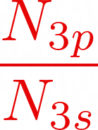
02 - Boltzmann Equation
= 0.005
Notes:
Obtain ratio of excited state to ground state atoms. Use Lande g-factors Arimondo et al. 1977. Roughly approximate the temperature of the sun by 5800K and the energy difference between the first excited state and ground state.

Slide 7


03 - Saha Equation
= 2365
Notes:
Ratio of neutral sodium atoms to ionized sodium atoms
Kb - Boltzmann constant, Teff - effective temp of sun (5800K), Z - partition function, Pe - electron pressure (1 N/m^2), h - planck constant, X - ionization energy (5.4ev)

Slide 8


04 - Na Abundance
N_{Na}/N_{H}= 2.08x10⁻⁶
= 6.3
Consistent with 6.21 from Scott et al. 2015!
Notes:
Solve for column density using results from Boltzmann and Saha equations (1.38x10^18 cm-2)
Assume hydrogen column density of 6.6x10^23 cm-2

Slide 9
Why is this result important?
Notes:
These processes or variations of them can be used to predict abundances on planets outside of our solar system using absorption, emission, and transmission spectra
Generally, this is much easier for hot planets with short orbits - UHJs
Can predict abundances and then go and try to detect them

Slide 10
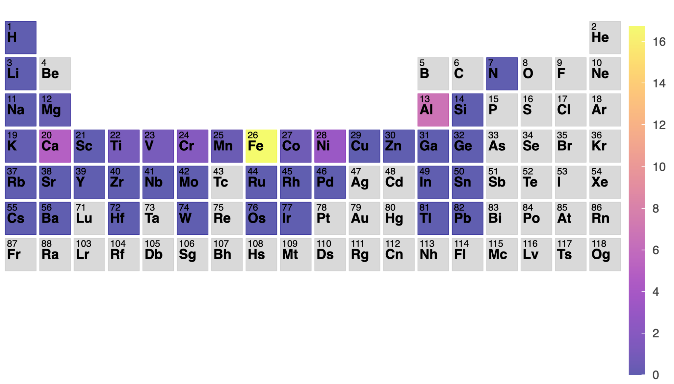
Neutral atomic species detectability in KELT-20b
Total Predicted Abundance
Petz et al. in prep
Notes:
Cool shit (Petz et al. 2023)

